Slide 1

DATA MODEL

Slide 2
Contents
Account
Service Instance
Products, Charges, Discounts, Unit Credits,Contracts, Product Packages
Product Provisioning
Life Of An account
Account Hierarchies

Slide 3
Account

Slide 4
Account
Billable entity that receives invoices
Has a balance and a unique ID
Information includes:
Customer name/address
Payment method
Billing history
Tax exemptions
Account level rating information

Slide 5
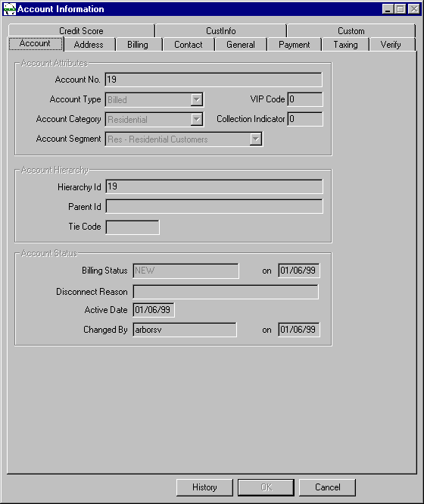
Account Attributes

Slide 6
Account Attributes
Account Number - Generated by system for new account
Account Type - Account Type (Billed/Unbilled)
Account Category - Category to which account belongs
Account Segment - Segmentation within each account category to which customer belongs
VIP Code - Priority assigned to Customer
Collection Indicator - Whether or not account is in Collections ?
Hierarchy Id - Account which is at the highest level in the hierarchy
Parent Id - Parent Account of the current account in hierarchy
Tie Code - Used for Reporting Purposes
Billing Status - Status of Account whether NEW,ACTIVE, DISC_REQ,DISC_DONE
Disconnect Reason - Reason for disconnect
Active Date - Date account will be active
Changed By - CSR userid

Slide 7
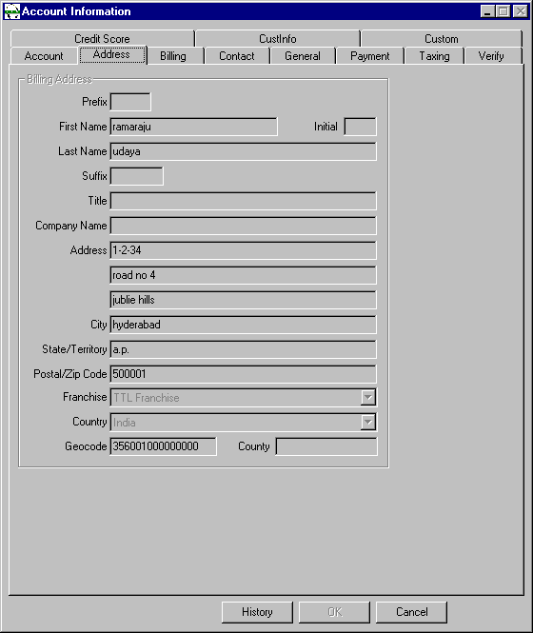

Slide 8
Address Screen Fields
Prefix - Title for Customers Name (Ms/Miss/Mr)
First Name - Customer’s First Name
Last Name - Customer’s Last Name
Initial - Customer’s Initial
Suffix - Any suffix to customer’s name e.g qualifications
Title - Customer’s title e.g Designation
Company Name - Name of the company (For Business Customers only)
Address - Customers Address
City - City
State/Territory - State
Postal/Zip Code - Pin Code for customer’s address
Franchise -
Country - Country
Geocode - Geocode of Customers Location
County - District

Slide 9
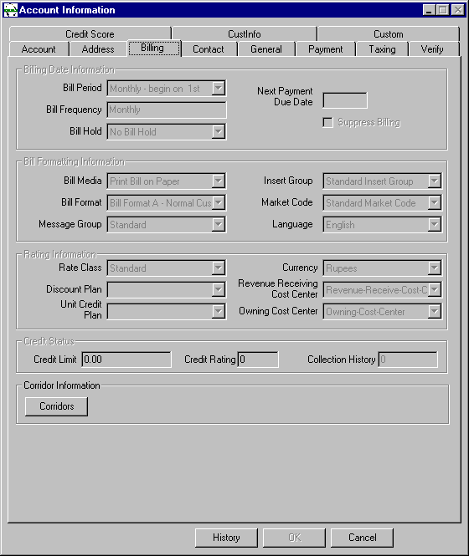
Billing Screen

Slide 10
Billing Screen fields
Bill Period - When the customer would like to be billed (Fortnightly for PTB Customer, Monthly for other categories)
Bill Frequency - Frequency of Billing (Fortnightly for PTB Customer, Monthly for other categories)
Bill Hold - Whether the bill should be dispatched to customer or put on hold for special handling
Bill Media - Media on which bill is sent to customer
Bill Format - Format in which bill will be produced
Suppress Billing - Whether billing is to be suppressed or not for the customer
Message Group - Controls the nature of messages that appear on the bill
Insert Group - Controls the nature of inserts that will accompany the bill
Market Code - Sub-categorization of bill message group. May also be used for journals

Slide 11
Billing Screen fields Contd..
Language - Language in which bill will be produced.
Rate Class - Different ways of rating a particular product or service for different categories of customers
Discount Plan - Drop down list with all discounts offered to the customer.
Unit Credit Plan - Drop down list with all unit credits offered to the customer.
Currency - Currency in which bill will be produced
Revenue Receiving Cost Center - Cost Center to which the charges will be booked to. Used for reporting purposes.
Owning Cost Center - Cost Center who owns the charges for the particular account.
Credit Limit - To be entered by CSR before committing the order. This field contains the credit limit of the customer
Credit Rating - To be entered by CSR before committing the order. This field contains the credit limit of the customer
Collection History - Shows the collection status of the customer in the past 12 billing periods
Corridors - Used to attach a corridor plan to the account

Slide 12
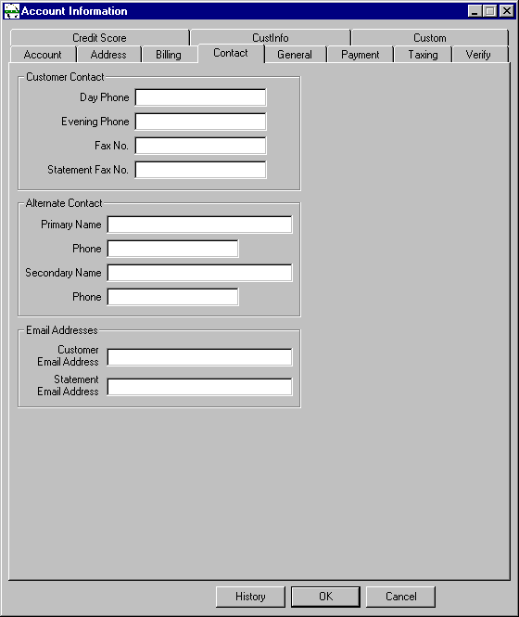

Slide 13
Contact Screen Fields
Customer Address
  Prime address for contacting customer
Alternate Address
  Alternate address for contacting customer
Email Addresses
  Email address of customer

Slide 14
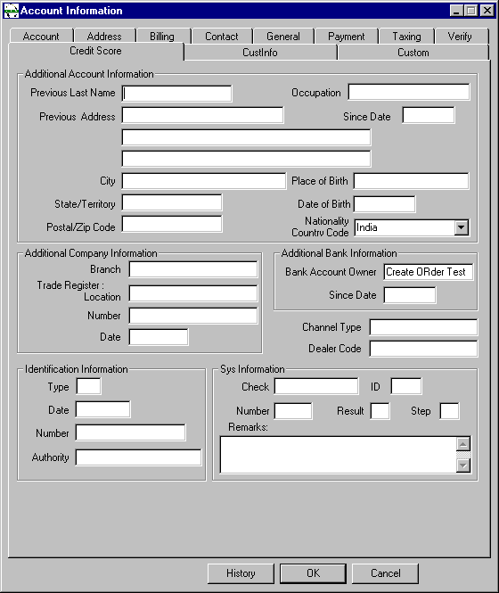
Credit Score Screen

Slide 15
Credit Score Screen Fields
Additional Account Information
  Enter details for customers belonging to S&E category
Identification Information
  The Number field will contain the PAN number of the customer

Slide 16
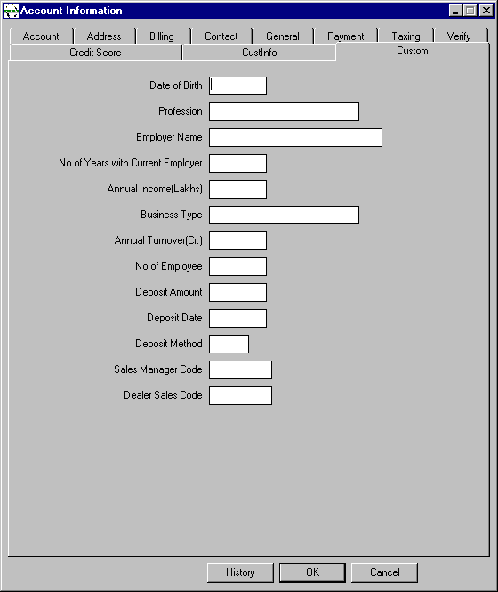
Custom Screen

Slide 17
Custom Screen fields
This screen is used to enter details of customer deposit etc.
The Sales Manager Code and the dealer code will also have to be entered on this screen

Slide 18
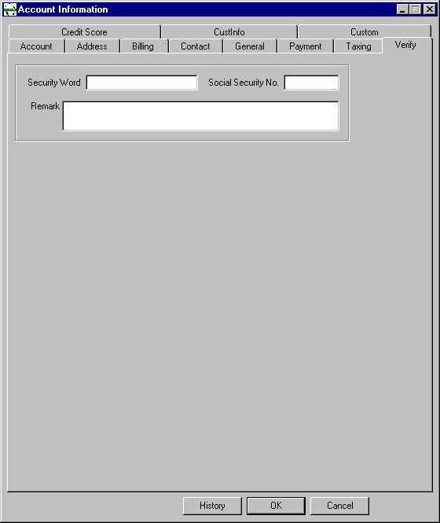
Verify Screen

Slide 19
Verify Screen Fields
Security Word
  This word is assigned to every customer upon entry into ARBOR/BP
Remarks
  Text associated with the security word
Security Word & Remarks must be furnished to CSR for any queries on the account

Slide 20
Service Instance

Slide 21
Service Instance
Network delivery point (for a particular account)
Has unique ID
Used in guiding usage records
Each account can have multiple service instances
Service types are important
  Rating
  Product provisioning and usage validation
  Bill formatting Service Instance Account with 2 service instances

Slide 22
Why service instances ?
They are key to guiding usage records
Different service instance types can be used to separate different usage types
Service types can affect bill formats
They can also be configured to reflect billing and usage collection system requirements
Separate addresses identify separate service instances

Slide 23
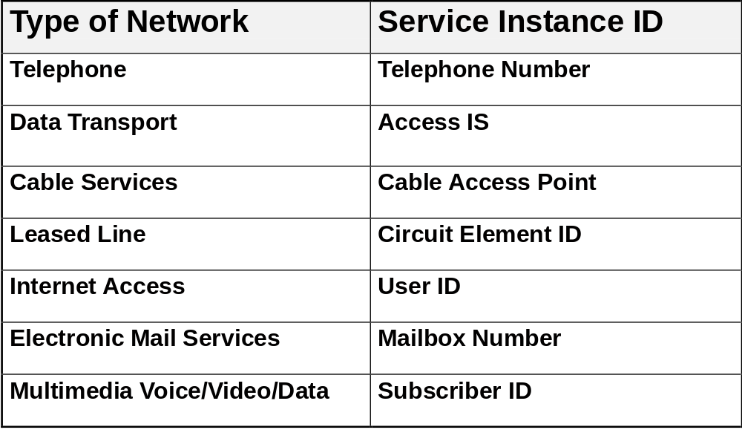
Examples of Service Instances

Slide 24
Service Instances in ARBOR/BP
Click and Drag the appropriate service instance to the customer account
Service Instance can be
  Standard Wireline
  Standard Wireless
  PTB Wireline
  PTB Wireless

Slide 25
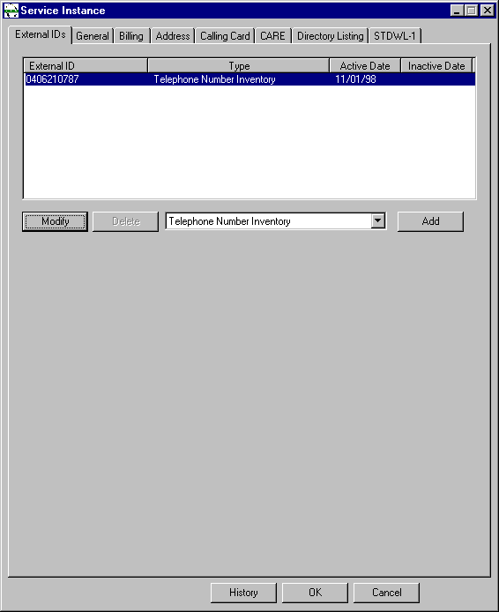
Service Instance Screen

Slide 26
Service Instance Add
Click Add
Select the Sales Channel Id
Query on the telephone number inventory
Select a number for the customer
Enter the active date of the service instance
Enter the house number and street on the address screen
Enter the address to be provided on the Directory Listing screen
GIS X&Y co-ordinates are to be filled from the customers application on the STDWL-1 screen
Click OK to add service instance

Slide 27
Service Instance Modify
Used to change the external id of the service instance

Slide 28
External ID
Identifier for ARBOR/BP to interact with external systems
Each external id is mapped to an internal identifier within ARBOR/BP for its internal operations
The external id appears on invoices, reports and other interactions outside ARBOR/BP

Slide 29
External Id - Contd ..
An account can have several external ids of the same type
An account can have several external ids of different types
Example
  An internal subscription number 123 could represent a telephone number 040 7730268 (external id)

Slide 30
Products

Slide 31
ARBOR/BP Products
Attached at service or account level
Have a related recurring charge
May have other related charges
Examples:Local telephone service
  Call waiting
  Voice mail
  Line rental
  Video conferencing service
  Internet connection
  Cable channels

Slide 32
Other Options for Products
Billed in arrears or advance
Proration for mid period connects/disconnects set separately by product
Auto credit may be on or off by product (whether a customer is entitled to a disconnect credit if service period was already billed)

Slide 33
Product Details
Each product = a recurring charge on the customer’s bill
Products can also be handled differently based on how they
  have been defined (not provisioned)
    Taxation
    Service types can affect rating for some products
    Units based rating may apply to leased line type products
    Products may be rated differently by rate class
    Products may be rated differently by component id if provisioned through a package

Slide 34
Product Element
A feature of a product that can be provisioned separately to a customer, and for which a regular charge is incurred.
Building block for configuring most products and services

Slide 35
CHARGES

Slide 36
Charges
Recurring
Non-recurring
Usage
Increase
Customer Balance
Adjustments
Credits
Discounts
Decrease
Customer Balance

Slide 37
Recurring Charges
Charges that are accrued by an account for every bill period till the termination of the account
Calculated by the invoice processor based on the frequency of billing of the account or the product
May be charged in advance or in arrears

Slide 38
Non-Recurring Charges
Used for one time fees
    Installation or activation
    Service calls not covered under other agreements
May be part of contracts & include penalty fees
May be applied at account or service instance level
Can be passed in from external interfaces using API functions

Slide 39
Usage Charges
Usage Charges are calculated by CAP when it is rating the usage
Stored in the customer database
The Invoice Processor does the final calculation of usage charges by applying discounts if any

Slide 40
Associating Charge Types with Products
Products link charges to the account
Charges are linked differently for the 3 basic charge types
Usage types must be grouped, and the group associated with the product element definition
RC rates are associated directly with the product element
NRC groupings are optional
Product
Element
Usage Type Group
NRC Type Group
RC Rates
Individual usage types
NRC Types
Usage Rates
NRC rates

Slide 41
Discounts and Unit Credits

Slide 42
Discounts & Unit Credits
Volume based discounts
  10% off of all charges after first £200
  5% off entire months charges if charges > £150
Unit credit plans
  30 minutes free air time per month
Complex restrictions
  15 minutes free airtime for long distance calls when using Provider ‘X’
Rate promotions
  20% off all long distance calls made on New Years Day
Multiple discount & unit credit plans can be combined

Slide 43
Discounts
Two kinds
    Incremental (Tiered)
    Bulk (Tapered)
If total charges are over $50, 10% discount applies to all the usage
10% off charges over $50
$50
$50
5% off first $50 worth of charges
If total charges are under $50, 5% discount applies
Incremental
Bulk

Slide 44
Discounts Plans
Discounts:
    Are linked to accounts or service instances through discount plans
      Service instance level - only charges for that service instance qualify for the discount
      Account level - any charge billed to that account can qualify
    Can also be linked through contracts
    Their assignment level determines which charges they affect
Account
Discount
Plan
Service
Instance
Discount
Plan
Individual
Discounts
Product

Slide 45
Discount Calculation
How Arbor/BP calculates discounts:
    Sum value of discountable charges
    Calculate discount amount
    Back-allocate discount among qualifying charges
Formula
charge amount
X discount percent
total qualifying charges
Excess remainders can either be discarded or allocated.
Bill calculator process does the discounting at billing time.

Slide 46
Discount Rates
Discounts have their own rate table.
    Can be either percentages or fixed amount rebates
    Any number of discount bands (thresholds) may be defined
    Will not be greater than total charges discounted
System wide parameters control:
    Number of decimals used for “percentage-off” discounts
    Double dipping
    What to do with remainders after back allocation

Slide 47
UNIT CREDITS

Slide 48
What Are Unit Credits?
Like discounts, but used to distribute free usage
    5 hours per month free
Linked to accounts or service instances through unit credit plans
Can be included in contracts
Two methods of allocation for account level unit credits:
    Credits allocated and distributed once across all service instances
    Each service instance will receive the credits

Slide 49
Unit Credit Rates
Can vary based on account attributes
Number of free ratable units
Unit credits are “use or lose”
Applied every bill cycle

Slide 50
Unit Credit Plans
Unit credit plans group individual unit credits
The plans are attached to accounts or service instances
Can be included in contracts
Account
Discount Plan
Unit Credit Plan
Service
Instance
Discount Plan
Product
Unit Credit Plan

Slide 51
Discount and Unit Credit Plans Are Promotions
The “Discount Plan” and “Unit Credit Plan” pick lists appear on the Billing Information window and also on each Service Instance/Equipment window
Site specific
CSRs must be familiar with the promotions and how they are designed to work

Slide 52
Contracts

Slide 53
Contracts
Discount Plans
Unit Credit Plans
Recurring Charges
Activation NRC
Termination NRC
Duration
Time Based Promotion

Slide 54
Adding Account Level Contracts
Access contracts through icon or Account menu on CUSTINFO
  Add
  Select Contract Type
  Enter start date
  End date is optional
  Enter optional grace period - (# of days after contract expires the contract is still effective)
  Note option to waive activation charge
  Save

Slide 55
Terminating Contracts
Contracts may be terminated early
    Select line item in Contracts window
    Terminate…
    Enter date and reason
    Save
Termination charges may apply based on how the contract
type is set up

Slide 56
Adding Service Instance Level Contracts
Add using contract button from the Service Instance (UNIX) or Equipment Screen (NT)
contract type - required
active date - required
end date - optional
waive activiation charges - optional
grace period - optional (# of days contract is effective after end date

Slide 57
Prorating Discounts and Unit Credits in Contracts
If a contract is only active for a partial service period
    Full discount if contract is active at start of bill cycle or at any point during the bill cycle
    Cycle independent unit credits will apply only to usage occurring before the contract expiration during the bill cycle
    Other unit credit plans must be active on cycle date in order to apply

Slide 58
Product Packages

Slide 59

Product Packages
1
Package
“Bundle” Concept
products and contracts
provides limitations, durations, & rating key
2
Account
Result
3

Slide 60
Product Packages
Packages are provisioned to accounts
Package components are provisioned to accounts or service instances
  Components can contain products or contracts

Slide 61
A La Carte Products
Products not included in a package
Access using the Products not Attached
Service (Subscriber) Level
Account Level
Choose a product from the Feature pick list
Enter a start date
Billing Options - Advance/Arrears
Rate - default or override

Slide 62
Product Hierarchy
Grouping of product elements into product lines which in turn can be assembled into product groups
Product Groups are used for reporting purposes

Slide 63
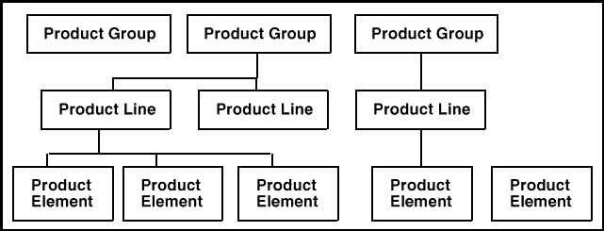
Product Hierarchy

Slide 64
Sample Account Structure
Account may have 0 or more service instances
Products may be attached to service instance or account
Service Instance at
Account Level
Service Instance
Products attached
to service instances

Slide 65
Sample Account Structure
Rate Class
Account level items can affect any charge associated with that account
Service instance level discounts and contracts only affect charges associated with that service instance
  This includes charges billed to this account from other accounts
Discount Plan
Unit Credit Plan
Rate Class
Discount Plan
Unit Credit Plan

Slide 66
Sample Account Structure (Detail)
Rate Class
Account level items can affect any charge associated with that account
Service instance level discounts and contracts only affect charges associated with that service instance
  This includes charges billed to this account from other accounts
Discount Plan
Unit Credit Plan
Rate Class
Discount Plan
Unit Credit Plan

Slide 67
Product Provisioning

Slide 68
Account/Service Attributes Affecting Provisioning
When CSRs provision products or packages, only eligible ones
  will show up on the pick lists.
Package components may be provisioned across an account
  hierarchy.
Some product packages can be limited to accounts by:
  Account category
  Market code
  Rate class
Components within product packages can be limited also:
  Account level components use same account attributes as packages
  Service level components use rate class and service type

Slide 69
Provisioning a Package or Product
Open account and open the product package window
Add package
Enter active date to apply to all components associated in this session
      Associate any required components
      Pick list will show service instances or accounts, depending on component level
      Can go against any account (or service instance belonging to any account) in the hierarchy
      Duplicate to provision same component again
Click Add to provision all selected associations
Can come back and do more later for optional components or
  components which can be provisioned multiple times
NOTE: No charges will be billed until components have been Associated

Slide 70
Viewing Component Elements
Filter in Packages window to see provisioned packages
    Select component to view
    Click Elements
      Features are products
      Contracts are contracts
      These can be modified (start dates)

Slide 71
Entering RC Overrides for Products
Overrides for previously provisioned products or new ones
    Select a component or Products Not Attached in the Packages window
    Click Elements
    Select product from Component Elements window
    Click View/Modify
    Click Modify in the Modify Product window - or add if the first time
    Enter override rate and dates it is active
    Save

Slide 72
Life of an Account

Slide 73
Process Flow: Life of an Account
The next few slides show how the Arbor/BP process flow is used for a single customer account
  New account activation
  Billing for service
  Payment
  A/R
  Ongoing account management
  Account closing

Slide 74
Life of an Account, Setup
Account is created in billing database
  Name, address
  Active date
  Payment method and details
  Billing frequency, media, currency, language, rate class, discounts
  Service type, active date, rate class, discounts
  Products assigned with active dates
  Optionally
    > Contracts
    > NRCs
    > Product packages
Account is also provisioned on network
Account billing status = NEW

Slide 75
Life of an Account, Service is Used
Usage collected
Additionally, customer may have leased or rental service which will be assessed at billing time

Slide 76
Life of an Account, Bill is Calculated
Arbor/BP BIP process is run
  Account selected and service dates determined
  Unbilled up to cutoff date summed by type
  RCs created from active products
  Unbilled NRCs collected
  Unit credits and discounts calculated
  Taxes computed
  Invoice with unique reference number created
  Account balance is updated
  Balances for credit card/EFT payers noted for subsequent processing
Account billing status = CURRENT

Slide 77
Life of an Account, Bill is Formatted
Arbor/BP BIF process is run
  Unformatted invoices are formatted
  Screen and print images created
  Dispatch files created for print or other devices
  Special Hold queues are possible, if customer is marked as Bill Hold

Slide 78
Life of an Account, Bill is Dispatched
Arbor/BP BID process is run
  Dispatches all print files to print devices
  Batches may be re-sent if needed
Alternate dispatch methods possible
  Tape
  FTP
  Using manual transfer (not using BID)

Slide 79
Life of an Account, Balance is Tracked
Account balance
  Increases through bill calculation and adjustment reversals
  Decrease through payments and adjustments
Transactions journalized through Arbor/BP JNL process
COL process is run for past due accounts

Slide 80
Life of an Account, Ongoing Service
Customer inquiries
Changes of address, some billing options (NOT currency)
Add/disconnect services, products
Issue credits
Other account management as needed

Slide 81
Life of an Account, Disconnect
Customer requests account be closed
  Disconnect all products, services, and then account itself
  Account billing status = DISC_REQ
  Final bill calculated, formatted, dispatched
  Final payment is received and balance brought to 0
    > If payment is not received, can write off balance instead
  Account billing status = DISC_DONE
  Billing records remain until archived

Slide 82
Other Account Operations
For accounts with payment problems, other operations are possible:
  Suspend/resume service
  Terminate disconnect all services
  Still need to issue final bill and bring balance to 0
  Write-off - if account balance is uncollectable, account can be written off, after all services are disconnected
Cannot post regular payments to closed or written off accounts
Can post bad debt recoveries

Slide 83

Invoices
For each account
Unique Number
Various Formatting Options Available
Mr. C Beans
25 Liberty Plaza
FHZ244
Europe
STATEMENT OF ACCOUNT
INVOICE N° 12437435
PRODUCT QTY EURO
CVNS 1282 1244.00
CPRS 1000 1022.00
- - - - - - - - - - - - - - - - - - - - - - - - - - - - -
TOTAL 2266.00

Slide 84
Account and Service Level Product Uniqueness
CMF account_no
CMF_PRODUCTS tracking_id
server_id
EMF subscr_no
subscr_no_resets
EMF_PRODUCTS tracking_id
server_id

Slide 85
Invoice Number Uniqueness
Invoice numbers (bill_ref_no) are controlled through the Admin DB
Uniqueness id bill_ref_no + resets
Blocks of invoice numbers are handed out to be cached locally on Customer DBs
Each Customer BIP gets the next bill_ref_no locally
BIP goes to Admin DB’s BILL_REF_NO_MASTER table for another block when it runs out
Updates master table’s next number (and the resets if needed)

Slide 86
Account Hierarchy
A set of accounts that own one another, often representing a set of departments of a single corporate entity.

Slide 87
Account Hierarchies
Accounts linked through Parent Ids
Browser makes for organized display of accounts in hierarchy
Bill-to accounts must be in same hierarchy

Slide 88
Billing Charges to Other Accounts
Charges from a service instance-level product can be billed to another account in the same hierarchy
Charges from account-level products can also be billed to another account in the same hierarchy
RC
1
2
3
B
Usg
RC
NRC
A

Slide 89
Billed vs. Unbilled Accounts
Unbilled accounts can own products or services, but the charges must be billed to another account
They cannot be a “bill-to” account for other accounts
Can be used as place holders in hierarchies

Slide 90
HQ Discounting
What is HQ Discounting?
Distribute discounts to multiple, separately billed accounts
HQ discount group
Distribute discount two ways:
Proportional
Pre-defined fraction
Group Participants
Same account hierarchy
Same billing cycle
Same bill period
Same currency code

Slide 91
The SYSTEM_ PARAMETERS Table
Use this table to control important Arbor/BP operational parameters such as:
  Discounting factors such as rounding, double dipping
  Amount at which an account enters collections
  Timezone conversion
  Error limits for usage guiding/rating
  Other parameters may apply to various Arbor/BP processes

Slide 92
References
ARBOR/BP Guide To Products, Rates & Discounts

Slide 93
End Of Document

